Slide 1
Time Series Analysis: Pizza Sales SeAN KENNEDY, SMU
Large PIZZA DELIVERY CHAIN
CREDIT CARD SALES DATA
DAILY FREQUENCY
7 YEAR HISTORY (2013-2020)
This analysis will benefit my firm as a useful predictor of the same store sales KPI as credit card data is strongly correlated to this metric
The analysis could also benefit companies in the restaurant industry that wish to analyze the change in spending trends as a result of COVID
See github repo for further details on data collection and fields
https://github.com/ethereum-ninja/SMU/tree/master/Time%20Series/project

Slide 2
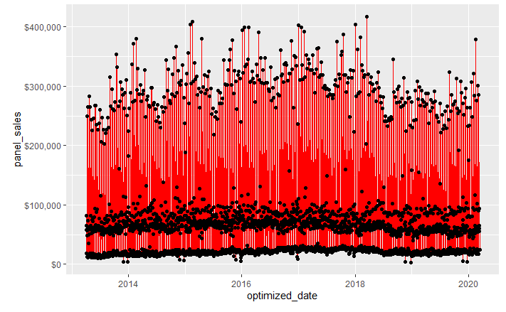
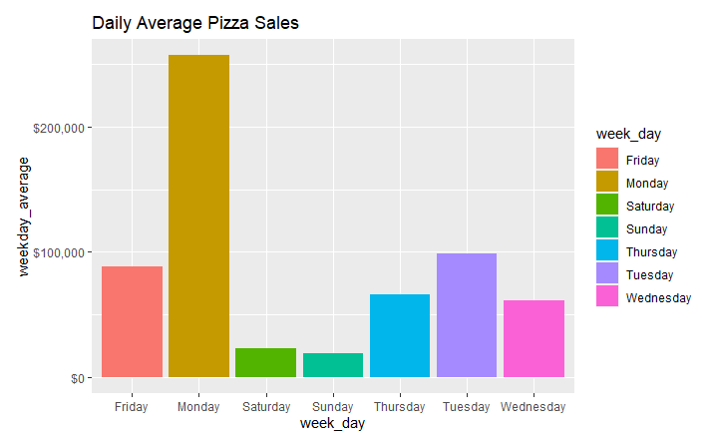
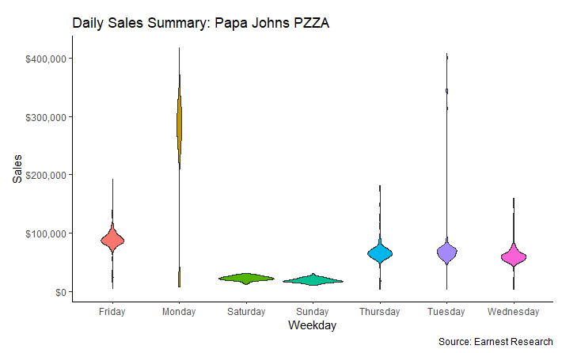
Stationarity
Data is clearly non-stationary. Mean depends on time – as it should – there should be observable social trends that make certain days more likely than others.
From the violin plots, we can see that variance is also not constant.

Slide 3
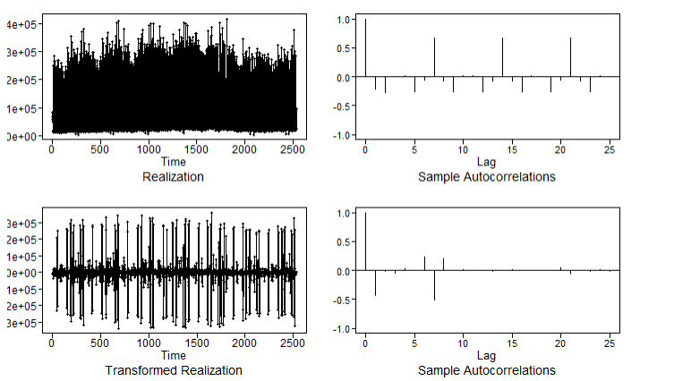
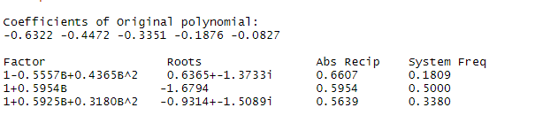
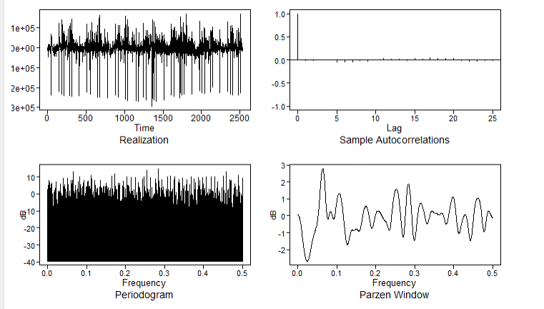
Model SELECTION: ARUMA
ARUMA(5,0,7) s=7: FAVORED BY BIC
Transformation:
Taking 7th Order Difference to Model Seasonality
Further modeling still required
Factor Table:
The ARMA(5,7) modeling of the differenced series has a factor table that captures our known system frequencies fairly well
Residuals:
Although the residuals fail the Ljeung-Box test, the ACF plots and spectral density of the residuals appear to be white noise. All autocorrelations past lag 1 are zero and the resulting spectral density appears random.

Slide 4
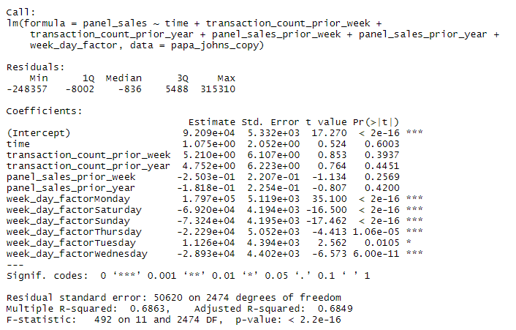
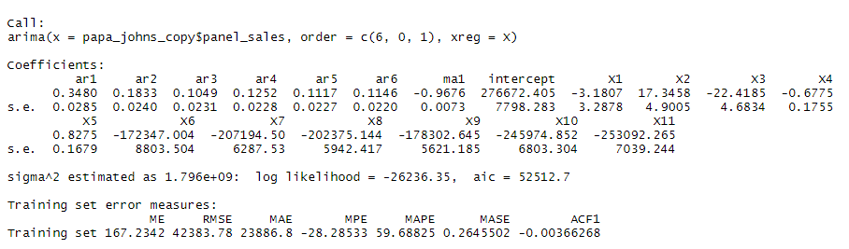
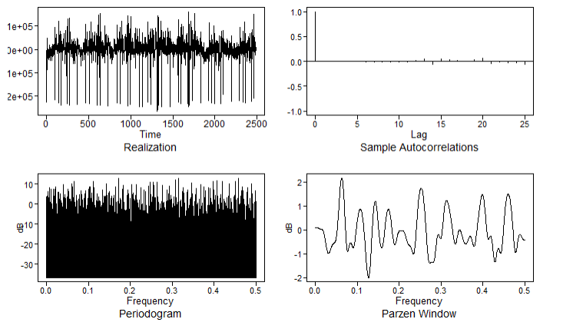
Model SELECTION: VAR
Including the following features:
Time, Prior_week_trAnsactions (numeric), Prior_YEAR_trAnsactions (numeric), Prior_week_panel_sales (numeric), Prior_YEAR_panel_sales (numeric), DAY_OF_WEEK (categorical)
Build a GLM with the new set of exogeneous variables
Model the Residuals as AR Process
BIC selected an ARIMA(7,0,1)
Adding in exogeneous variables makes this an ARIMA-X model
The transaction count variables (X2/3) are oddly significant
Variables X6-X11 represent the days of the week (Tues-Sun) and are adjustments to the intercept (Monday)
Residual Plots:
Appear to be white noise
Fail LB test

Slide 5
Model SELECTION: NN
Leveraging the previous example and using instead a NN
For training purposes, we will fit on a subset of the data
Model the Residuals as AR Process
BIC selected an ARIMA(6,0,1)
Adding in exogeneous variables makes this an ARIMA-X model
The transaction count variables (X2/3) are oddly significant
Variables X6-X11 represent the days of the week (Tues-Sun) and are adjustments to the intercept (Monday)
Residual Plots:
Appear to be white noise
Fail LB test

Slide 6
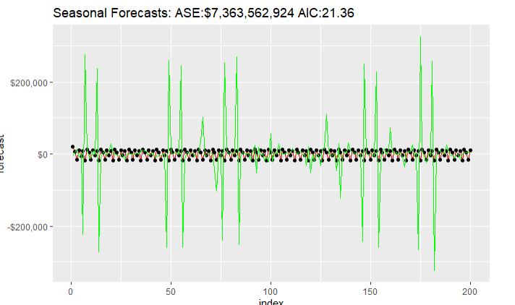
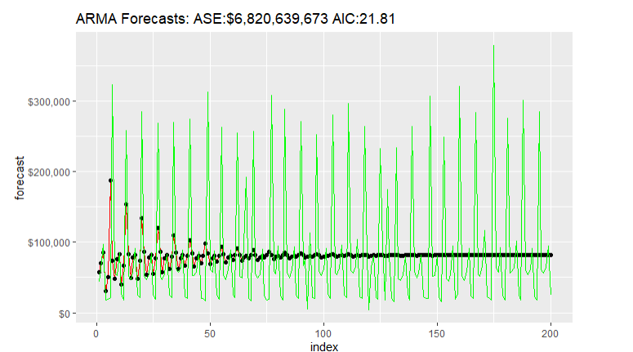
Forecasts
ARMA(9,2)
ARUMA(5,0,7) S=7
ARMA wins on AIC/ASE
ARUMA has a longer term horizon for accurate predictions
ARMA captures shorter term trends, but decays to mean after about 55 days

Slide 7
Conclusion

